Slide 1
Stochastic Processes - Baum welch algorithm -
In my presentation I’ll focus on this algorithm

Slide 2
Table of contents
01
02
03
04
Hidden Markov Model
Details about
Baum welch
Applications of algorithm
Advantages and Disadvantages of this algorithm

Slide 3
01
Hidden Markov Model

Slide 4
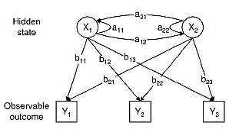
Hidden Markov Model
the Hidden Markov Models is a doubly stochastic process where one of the underlying stochastic process is hidden. The hidden process is a Markov chain going from one state to another but cannot be observed directly. The other process is observable and depends on the hidden states.
The goal of HMM is to capture the hidden information
from the observables.
X :- hidden states
Y :- observables
a :- transition probabilities : probability of moving from one state to another state
b :- emission probabilities : probability of an observation being generated from a state
X 0 :- initial probability distribution : probability that the Markov chain will start at a certain state

Slide 5
Three basic problems of HMMs
Evaluation:- computation of the probability of the observation sequence
→ Forward-Backward algorithm
→ given λ (π , P , E )
Decoding: determination of the most probable state sequence
→ Viterbi algorithm
Learning: determination of the parameters of the model (Estimation)
→ Baum-Welch algorithm (in this presentation)

Slide 6
02
Details about Baum welch

Slide 7
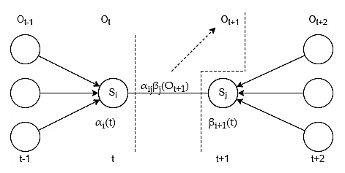
What is Baum welch algorithm?
Baum-Welch algorithm finds values for HMM parameters that best fit the observed data
Algorithm tries to estimate transition matrix A and emission matrix B using values of O and S.
The Baum-Welch algorithm is needed because the state paths are hidden, and the equations cannot be solved analytically.
It’s a special case of the EM algorithm (expectation–maximization algorithm) which is a method to find maximum a posteriori estimates of parameters in a statistical model.
To achieve this, the algorithm makes use of the
Forward-Backward algorithm.

Slide 8
Expectation maximization
Baum-Welch algorithm is using expectation maximization (EM) approach to find values for A and B.
Process looks following:
Initialize A and B with some initial values (done only once)
Estimate latent variables ξᵢⱼ(t) and γᵢ(t) (I’ll explain the meaning of these later) using A, B, O and S. Goal of this step is to estimate how much each transition and emission has been used. This is estimation step
Maximize values of A and B using estimations from previous steps. This is maximization step
Continue previous steps until convergence

Slide 9
1- Initial phase
In the initial phase, the content of the parameter matrices A, B, π₀ are initialized, and it could be done randomly if there is no prior knowledge about them.
Ex:- π = [ ]
P =
E =
0.99
0.01
0.99
0.01
0.01
0.99
0.8
0.2
0.1
0.9

Slide 10
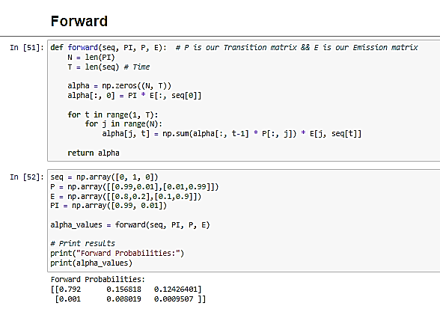
2- Forward phase
In the forward phase, the following recursive alpha function is calculated.
α^{j}_{t} = ∑ α^{i}_{t-1} * p_{ij} * E_{J}(O_{t})
The alpha function is defined as the joint probability of the observed data up to time k and the state at time k
alpha contains the information from the observed data up to time k, and to get the next alpha, we only need to reuse the current alpha, and add information about the transition to the next state and the next observed variable. This recursive behavior saves computations of getting the next alpha

Slide 11
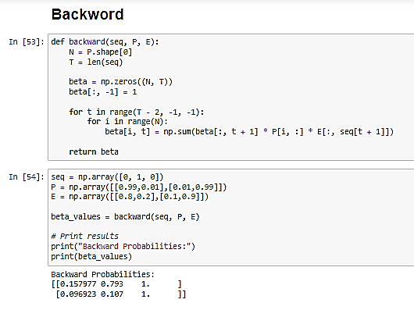
3- Backward phase
The beta function is defined as the conditional probability of the observed data from time k+1 given the state at time k
β^{i}_{t} = ∑ β^{k}_{t+1} * p_{ik} * E_{k}(O_{t+1})
It is a recursive function because the beta function appears in first term of the right hand side of the equation, meaning that the next beta is reused in the calculation of the current one. This is also why it is called a backward phase.

Slide 12
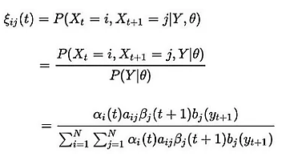
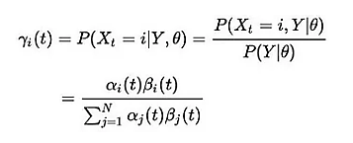
Some Equations
A = aᵢⱼ (probability of transition from hidden state i to hidden state j)
= expected number of transitions from hidden state i to state j /
expected number of transition from hidden state I
B = bⱼₖ (probability of observing observation Oₖ in hidden state j)
= expected number of times model is in hidden state j and we observe Oₖ /
expected number of times in hidden state j
ξᵢⱼ(t):- probability of transition from hidden state i to
hidden state j at time t given observations:
γᵢ(t)-probability at given state i at time t given observations.
EX: Y₁ ^{A} = ∑ E^{AA}₁ * E^{AB}₁

Slide 13
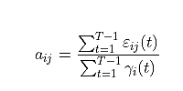

Some Equations conts.
All the previous equation use to estimate the parameter let’s go:
. a_{ij} probability of transition from hidden state i to hidden state j
. b_{jk} probability of a observation Oₖ from the observations O given
hidden state j

Slide 14
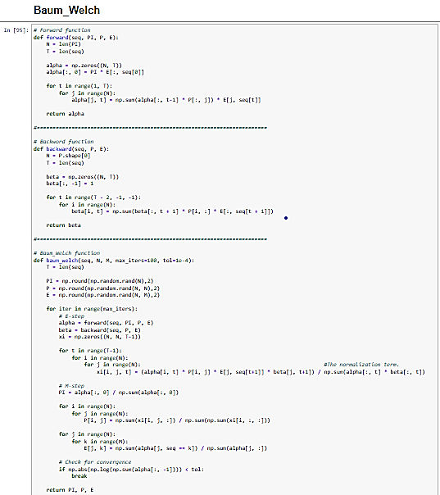
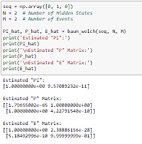
As code:

Slide 15
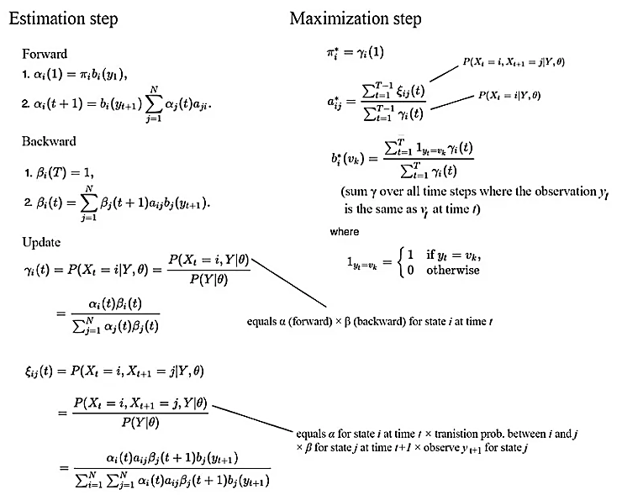
recap of the algorithm:

Slide 16
03
Applications of Algorithm

Slide 17

Speech Recognition:
One of the early and prominent applications of HMMs trained with the Baum-Welch algorithm is in speech recognition. HMMs can model the dynamics of phonemes and words, making them suitable for converting spoken language into text.

Slide 18

Bioinformatics
Baum-Welch is used in bioinformatics for tasks such as gene prediction and sequence alignment. HMMs can model biological sequences, and the algorithm helps train the models based on observed sequences.

Slide 19

Natural Language Processing (NLP):
In NLP, Baum-Welch is employed for tasks like part-of-speech tagging and named entity recognition. HMMs can model the sequential nature of language, and the algorithm helps adapt the models to observed language data.

Slide 20
04
Advantages and Disadvantages

Slide 21
Advantages of the algorithm:
its ability to estimate the parameters of an HMM when the training data only includes observations and not the underlying hidden states.
The algorithm seeks to maximize the likelihood of the observed data given the model parameters. By iteratively updating the parameters, it converges to a set that maximizes the probability of observing the given data under the assumed model.
The algorithm can handle cases where some information is missing or incomplete in the observed data.
Under certain conditions, the Baum-Welch algorithm is guaranteed to converge to a local maximum of the likelihood function.

Slide 22
Disadvantage of this algorithm:
The algorithm's performance can be sensitive to the choice of initial parameter values. Poor initial conditions may lead to slow convergence or convergence to suboptimal solutions.
The algorithm assumes a specific model structure, such as conditional independence of observations given the hidden states. If this assumption does not hold in the real-world data, the model may not accurately capture the underlying dynamics.
Like many machine learning algorithms, there is a risk of overfitting.

Slide 23
Our team
Ziad Ashraf Ibrahim Taher
Ali Mohamed Sayed Ahmed
Mohamed Elsayed Ahmed
Abdullah Gaber Ashour
Abdelrahman Mohamed AbdelFattah
Ziad Abdo Ali
Ali Amr Ali
Abdelwahab Mohamed

Slide 24
Thanks!

